Slide 1


Slide 2
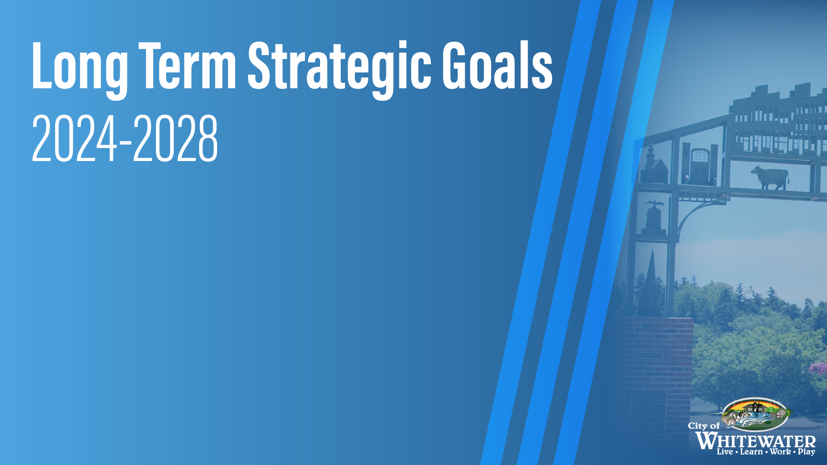
-Increase affordable housing for families
-Increase communication without a “newspaper”
-Support thriving businesses and grow the tax base
-Improve the City’s recruitment, retention, and diversity
-Align future expenditures with available resources

Slide 3
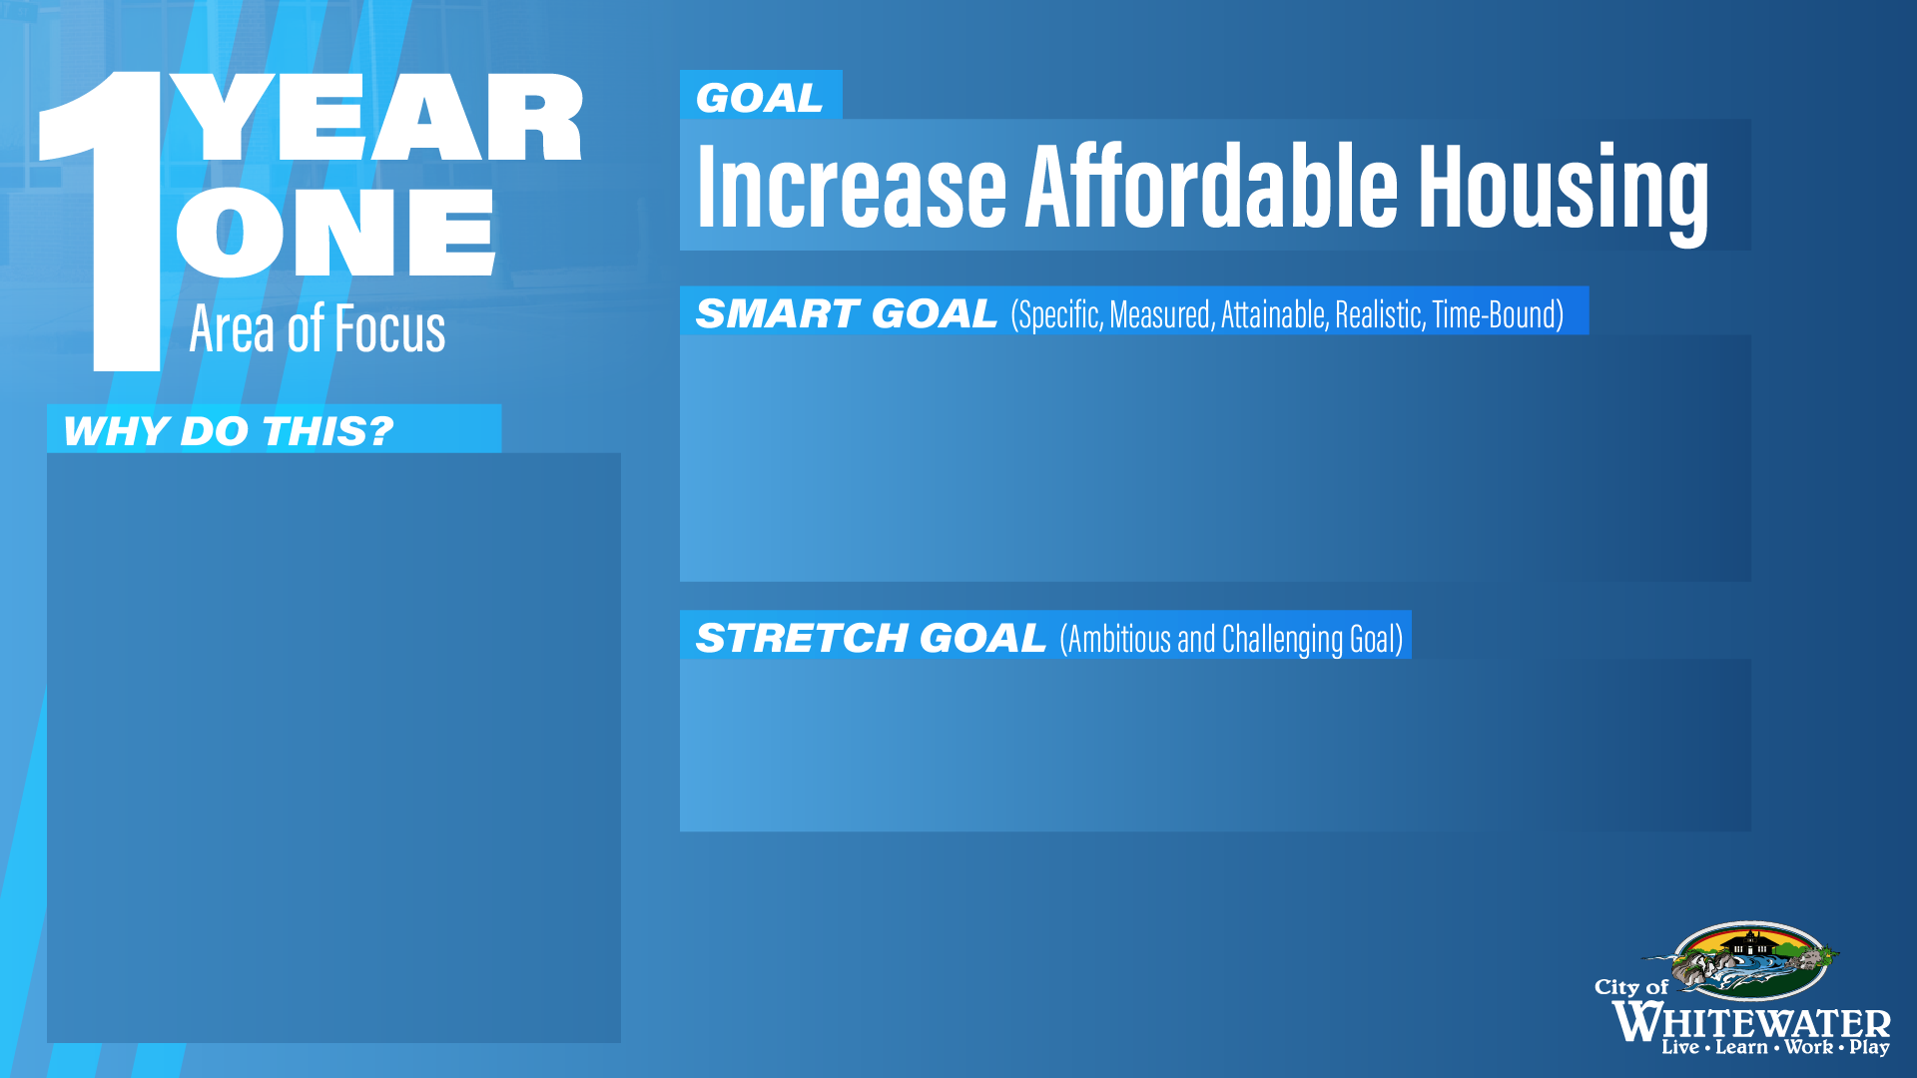


Using the Affordable Housing Policy and/or other
resources, facilitate the application and approval
of at least one residential development.
Numerous studies
demonstrate the need for
affordable housing in
Whitewater, as well as an
available market for
family-based single-family
attached, detached, and
multifamily units.
Three residential projects in the application/approval
process.
Notes:
The Affordable Housing Policy was approved by the Council in 2023. This is a 1.9 million dollar fund that is used to assist first-time home buyers. Since the approval several things have happened:
-1 Community Member was placed in a home
-1 Developer (Habitat for Humanity) was given funds for a current development
At the 3/5 Common Council Meeting, the language was changed to allow greater eligibility for future applicants -Change in HUD Income Limits from 100% to 150%
-Remove the current HUD county property value limit ($271,000) to accommodate new housing developments projected to be priced between $289,000 and $318,000.
-Specify that maximum mortgage payments must not exceed 30% of household gross income at application and loan closing.
-Staff hosted a roundtable discussion with developers, relators, landowners, and government officials- 67 people attended to talk about housing needs in Whitewater

Slide 4
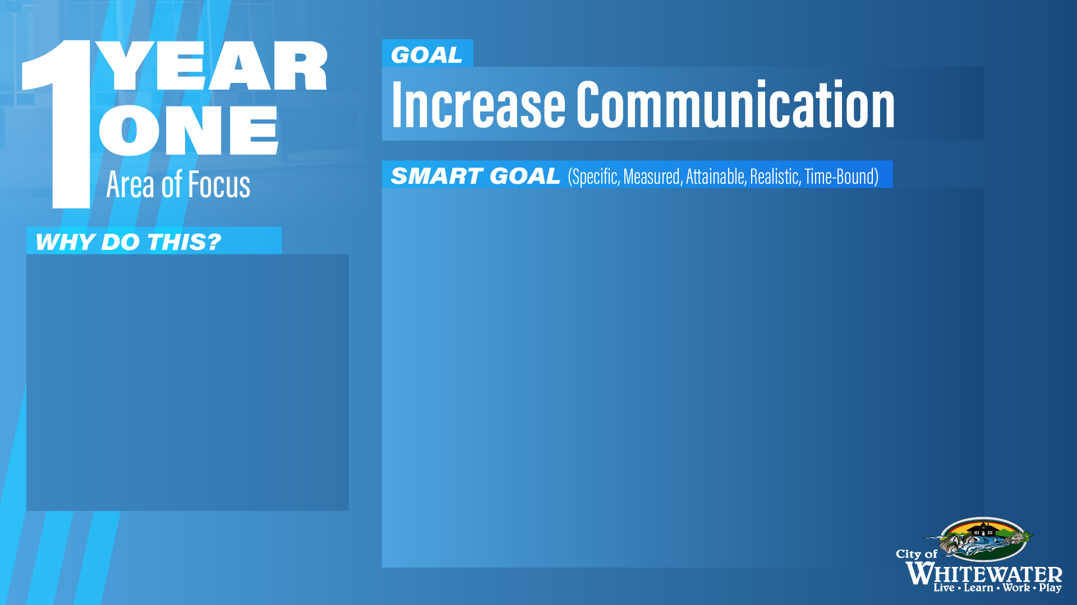
Improve market penetration, frequency, and quality
of communication with the public through social
media, press releases, and newsletter.
Revamp City website, including online forms,
payments.
Re-establish PEG station, including programming,
recording, and partnering with other agencies to
incorporate other programming.
By maintaining a strong
public engagement, the
City widens its pool of
people who can be
informed about information,
resources, and events.
Notes:
The Media Services Department has dedicated a considerable amount of resources to creating new content for our Social Media Platforms (Facebook and Instagram)
-June 2023 Staff started to keep track of the analytics of our social media. Our Facebook following increased by 15% from its initial following in June of 2023.
-Views on posts have seen a record high of 19,918 views
-Staff are currently working with Civic Plus for a website refresh that is to be completed by Q3. The refresh covers cosmetic features and translation elements.
-The PEG TV station was re-launched in August of 2023. Content plays 365 days a year.

Slide 5
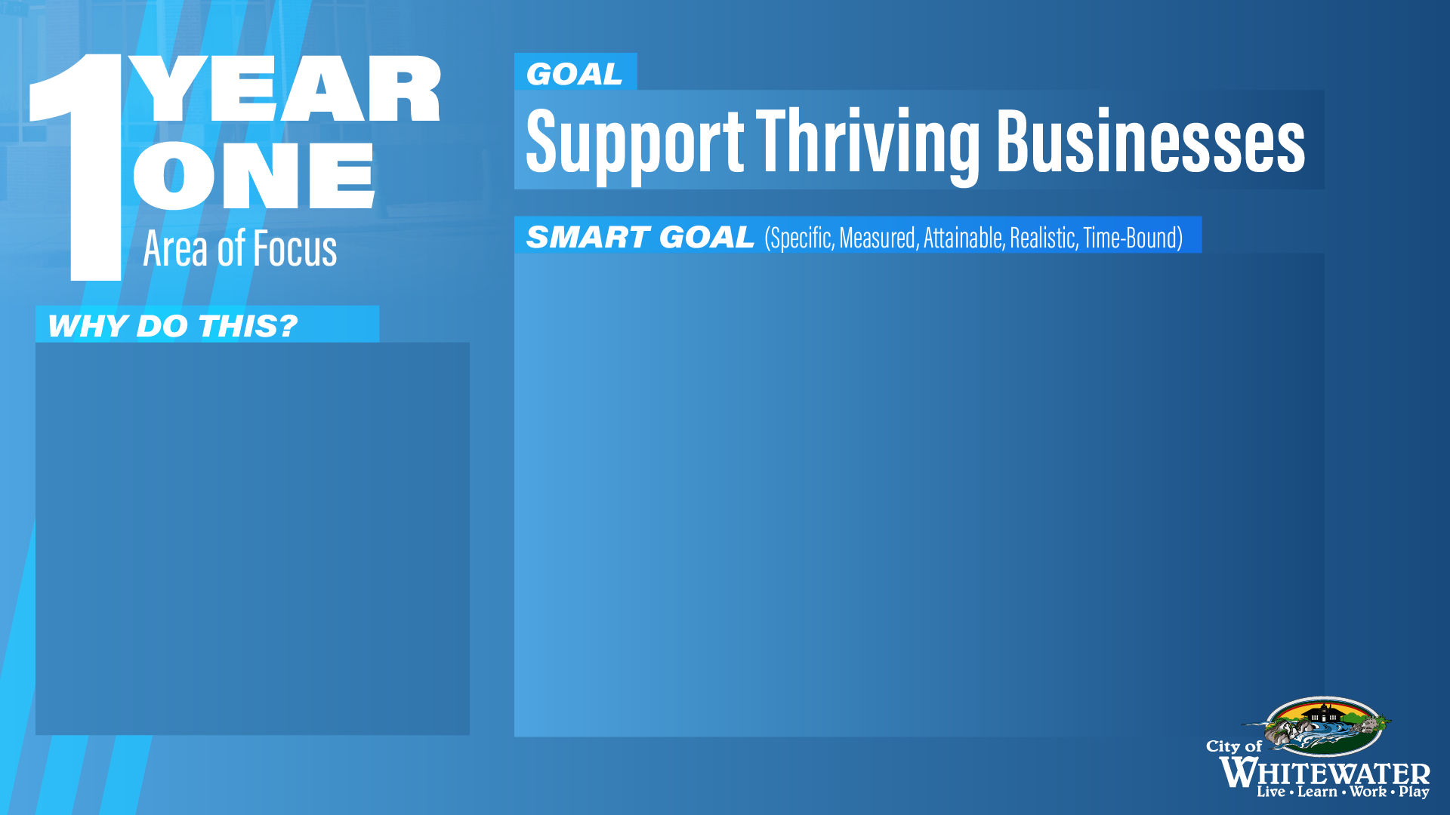

Partner with Thrive ED, JCDEC, and the Latino Academy
to have a job fair within the next calendar year.
Establish and conduct business recruitment,
retention, and expansion meetings with 25
businesses.
Assist CDA in revamping loan programs and
implementing affordable housing policy.
Assisting to establish
thriving businesses and
employment opportunities
establishes the City as a
problem solver and
supporter of the private
sector.
Notes:
In October of 2023 the City partnered with the Latinx Academy and Thrive ED/ JCEDC and completed a Latinx Job Fair. 8 Businesses were at the fair. Overall there were 47 attendees. The City handed out a total of 52 flyers- 42 Spanish and 10 English.
-Economic Development has completed 15 BRE’s in 2024
-The Office of Economic Development has been working with Kristen Fisch-Peterson on updates to our current Loan Program.
-CDA recently funded Whitewater WindUp as a recruitment mechanism to assist entrepreneurs and small businesses. There are currently 20 applicants in the Program. 8 Finalist moved on.

Slide 6
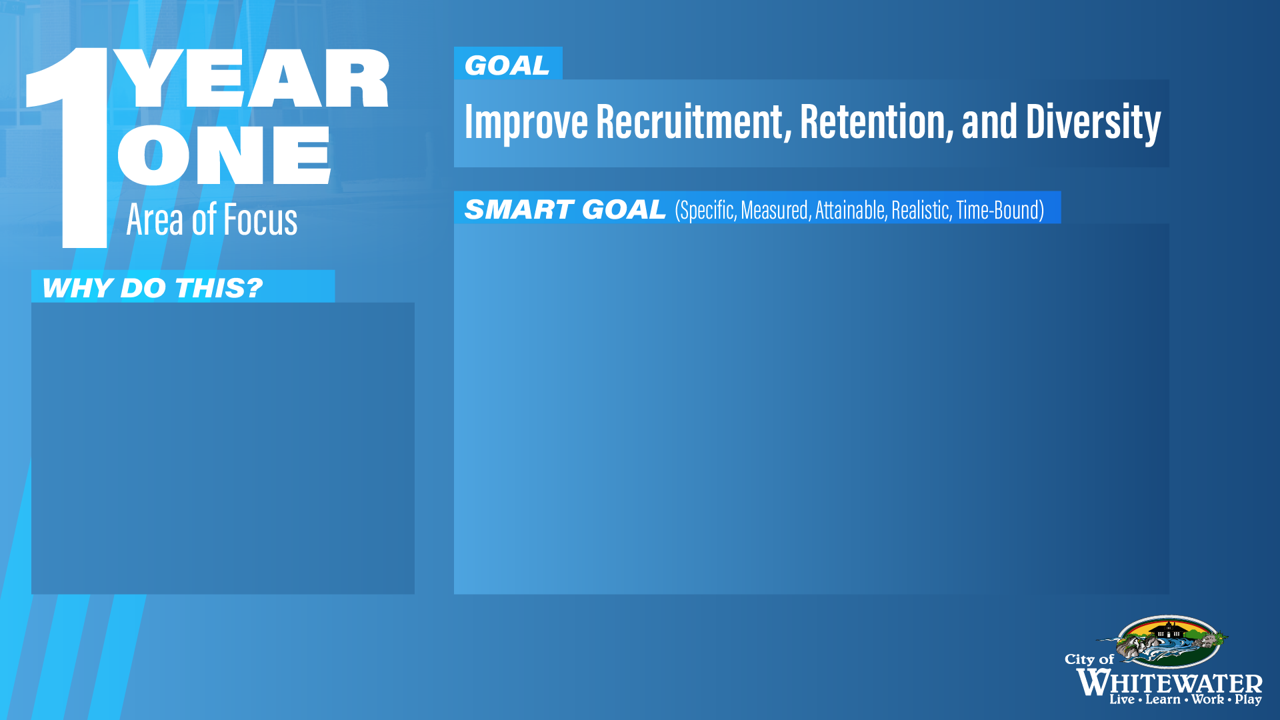
Finish update of employee handbook by Q2 2024
Establish stay interviews, leadership luncheons, and
other programs to support our staff and learn about
ways to improve.
Conduct an analysis of compensation for
non-management staff by Q2 2024
The employee handbook has not been
updated since 2011. Updating
modernizes the City and sets clear
expectations. As the main expenditure
and driver of our quality services, it is
in the City’s financial and operational
best interests to focus on the welfare of
its staff.
Notes:
HR- employee handbook out to City Council May 2024
Conducted 25 stay interviews and leadership luncheons-staff gave feedback on handbook
Salary Study completed April 2024

Slide 7
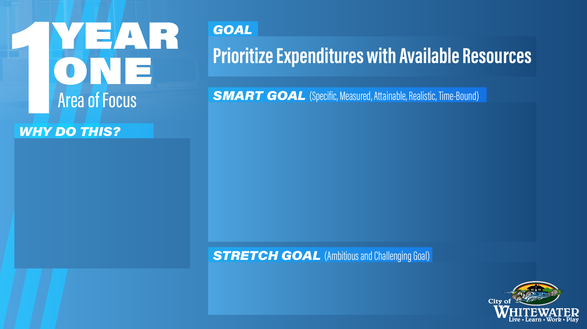
Successfully budgeted for 2024 reductions in
revenues totaling over $500,000 including: Municipal
Service Payments (MSP) from the State tied to police
services, totaling approximately $200,000, and from
the State for the Expenditure Restraint Program (ERP)
totaling approximately $70,000.
The MSP and ERP payments are
projected to return in 2025 and the
UWW payment is a permanent
reduction. The City needs to adjust
for these reductions while
maintaining its other commitments
to other services and our staff
No reductions in services. Maintain projected
2.25% raises for staff.
Notes:
Merging of roles and outsourced to a 3rd party-
Code enforcement
Neighbor Services
Communications Director
Executive Assistant
Total saving- $70201.14

Slide 8

Public Transportation
Complete a comprehensive evaluation of the financial and operational model of Brown Cab Services.
The community is looking for reliable and consistent transportation.
Potential for running the transportation service in-house

Slide 9
Emergent Healthcare
Identify potential healthcare partners to discuss the feasibility of establishing emergent healthcare services within the city
To have emergent healthcare services in the community.
Begin initial negotiations and planning with selected healthcare partners.

Slide 10
Communications
Expand video content to cover additional topics of community interest
To keep our community updated on the actions of the city government.
Establish a regular schedule for content creation

Slide 11
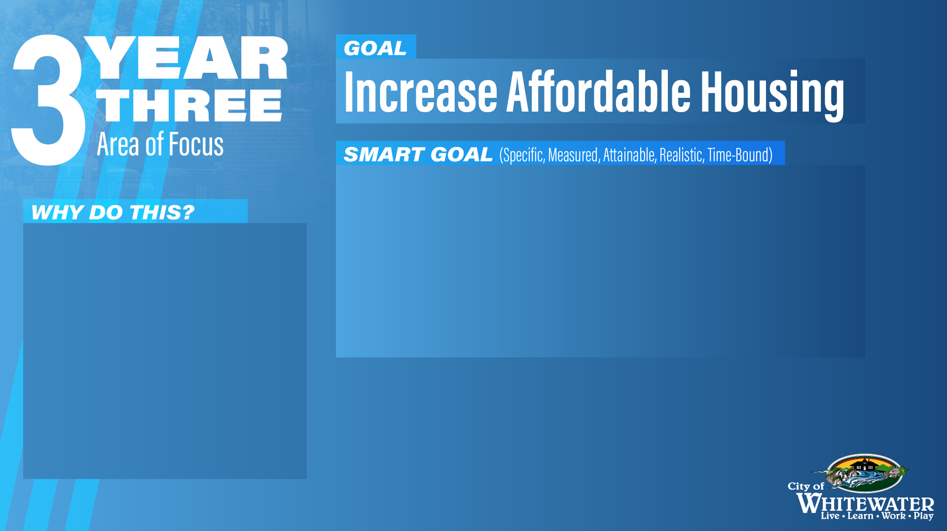
To have one or more housing projects underway or
under contract for development through an
agreement with the City or CDA or through approved
plans by the Plan and Architectural Review
Commission (PARC).
69.31% of the city’s single
family homes are rentals.
Creating single family
homes that are affordable
allows for single families or
growing families to
purchase these homes.
Notes:
Meadowview Development has began.
6 units have been spoken for
Moraine view Apartment complex has been approved by PARC, CDA and CC. The Development is just waiting on a conditional use of the PARC.

Slide 12

Public Transportation
Develop a detailed implementation plan for transitioning services in-house
Secure funding from City Council
To provide reliable and consistent transportation to our community.
Begin phased implementation of in-house transportation starting with a pilot program

Slide 13
Emergent Healthcare
Finalize agreements with healthcare partners for the establishment of emergent healthcare services in the city.
Begin construction or renovate of chosen facility
To have emergent healthcare services in the community
Develop a community outreach program to inform residents about upcoming healthcare services

Slide 14
Communications
Expand video content to cover additional hot-button topics in the community. Establish a regular schedule of content. Diversify the types of media that the City posts on social media.
To keep our community updated on the actions of the city government
Implement a feedback loop to continuously improve content based on community responses

Slide 15
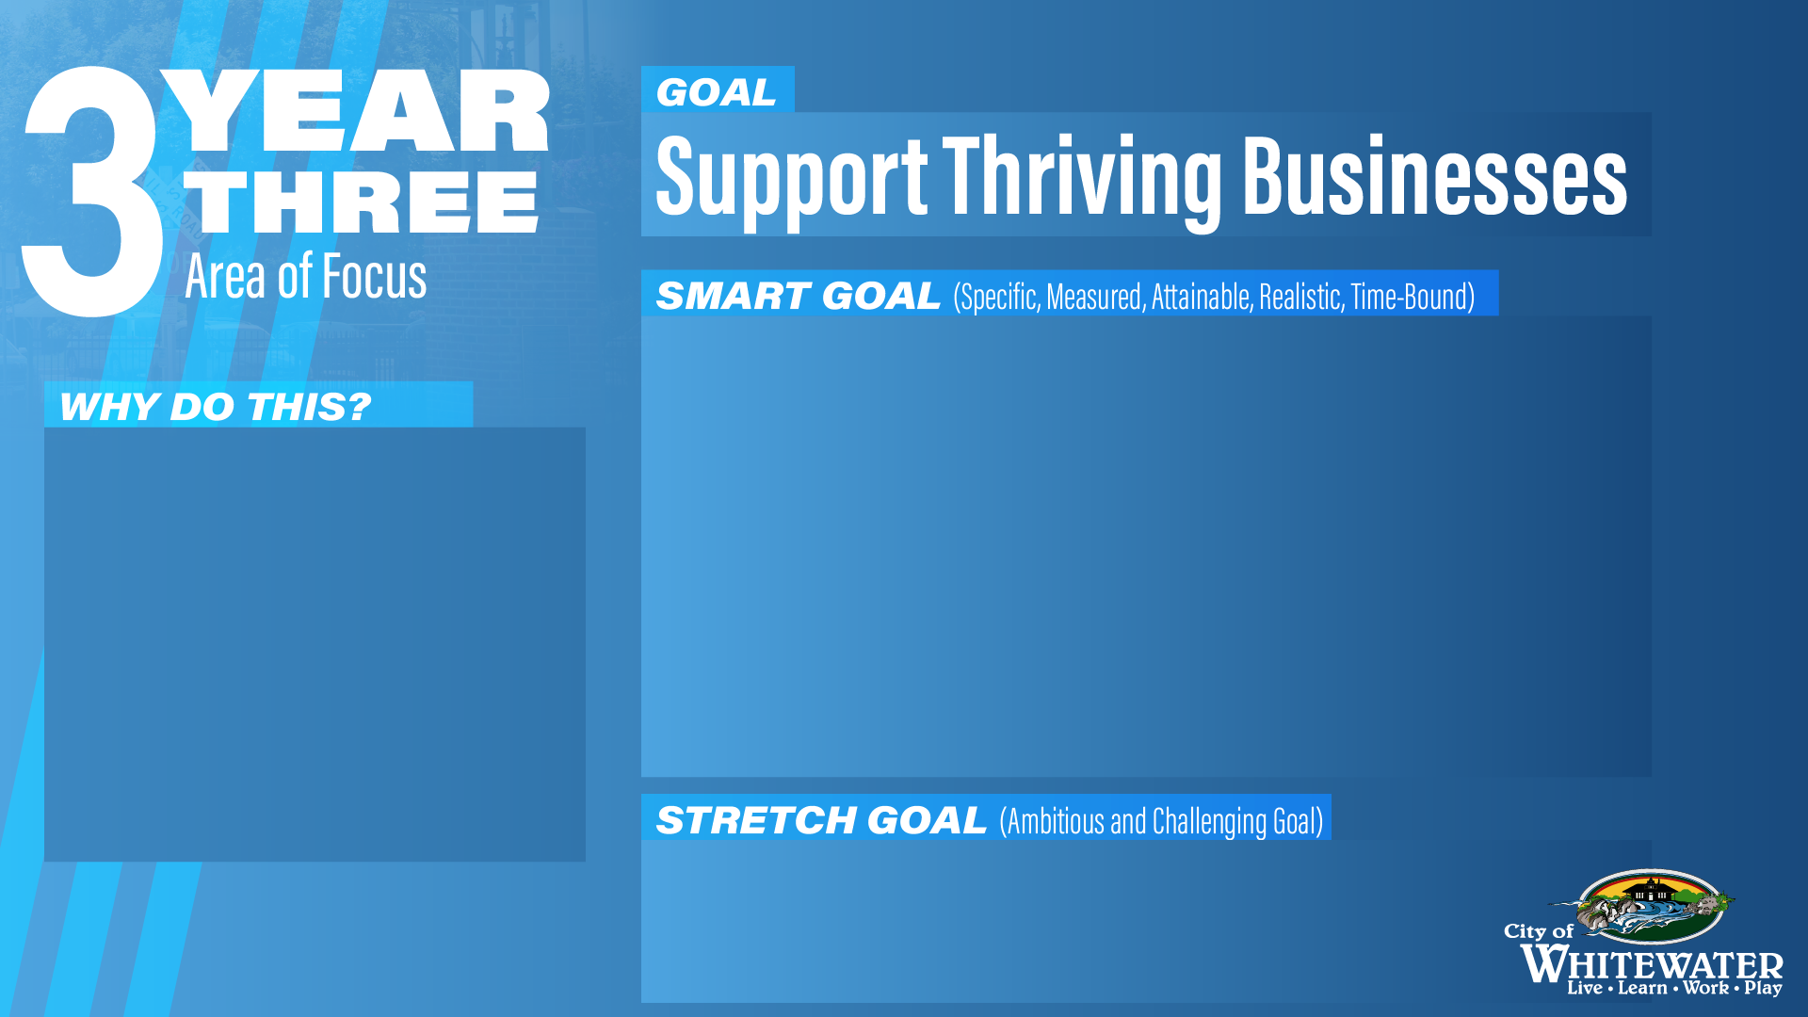
Provide online and in-person informational sessions
specific to permits, building codes, fire inspections,
water requirements, and street requirements to help
residents, entrepreneurs, and developers fully
understand how to succeed in Whitewater.
Maintain 25 BRE meetings per year.
Providing informational
sessions for local
businesses eliminates
obstacles and uncertainty
regarding best business
practices in the City.
Turn one Business Retention Expansion (BRE)
into a new development opportunity.
Notes:
BRE visits started in 2023.

Slide 16
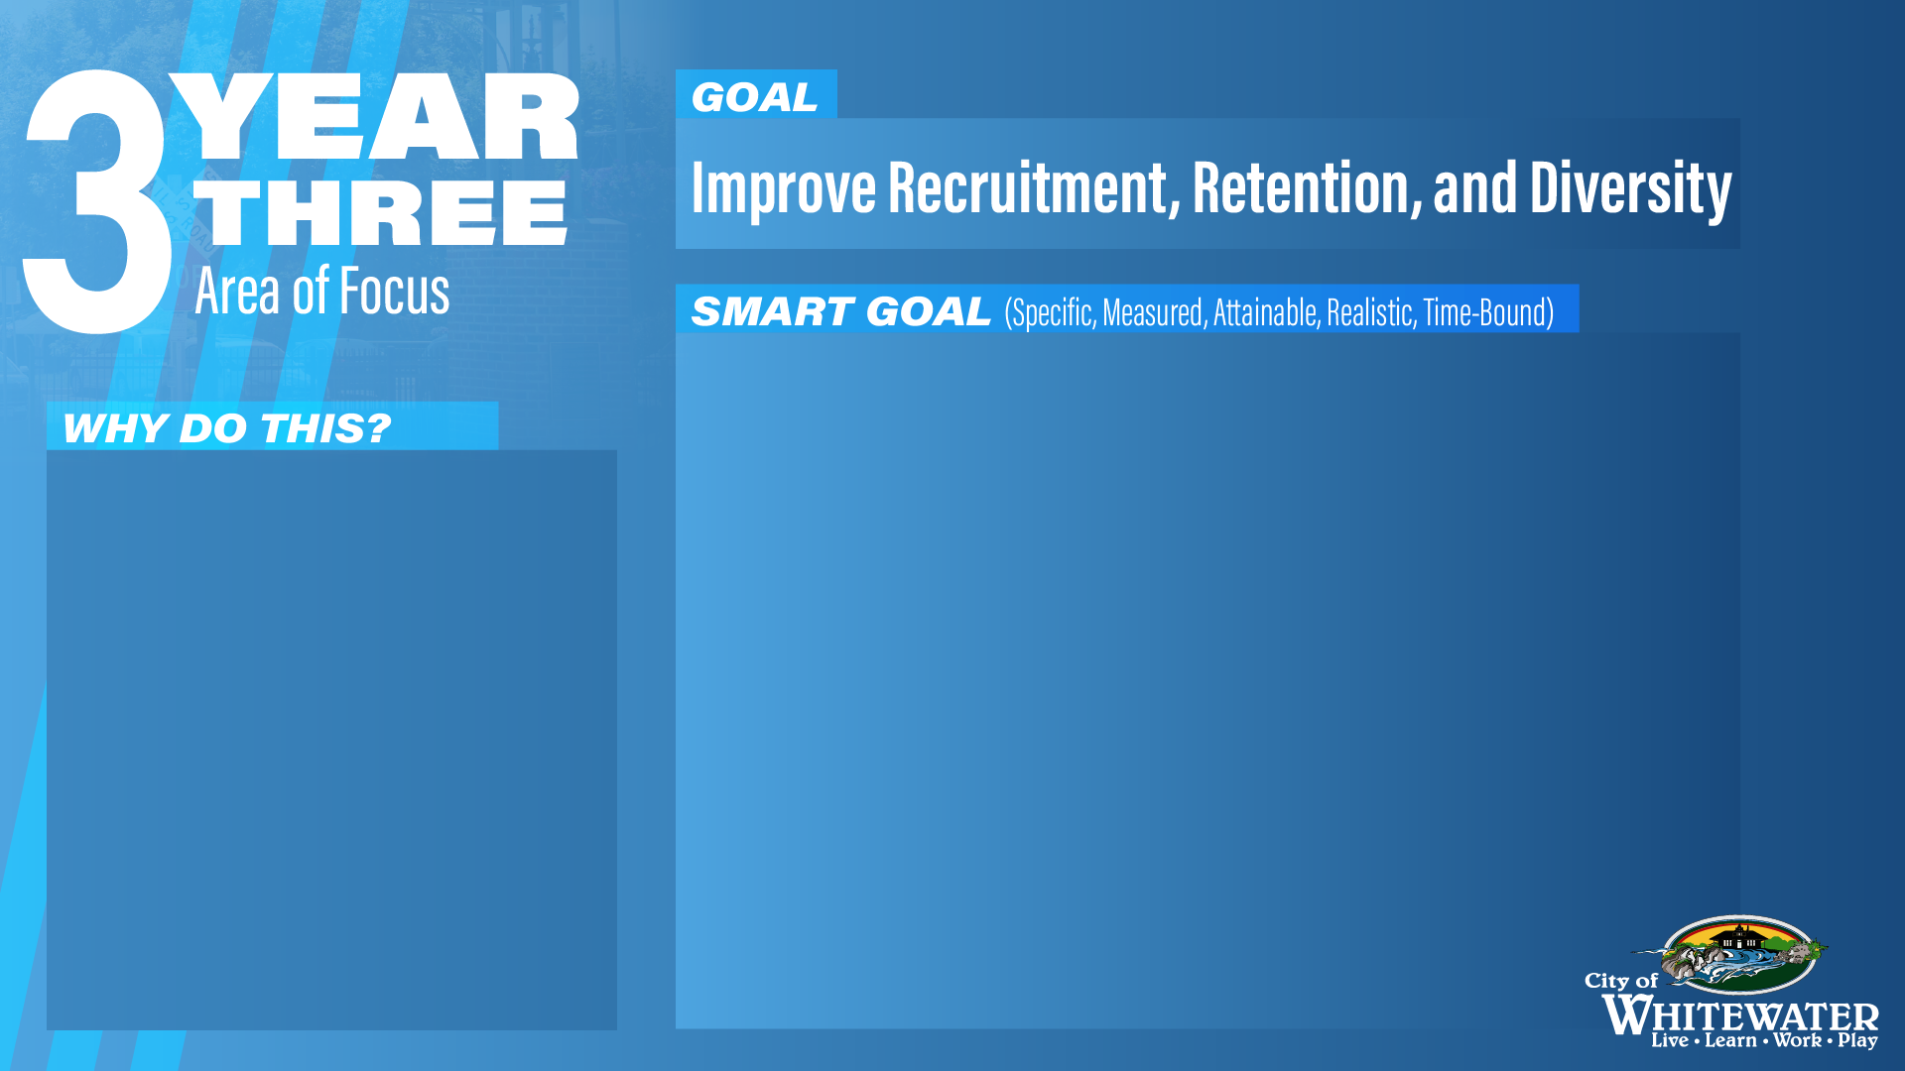
Promote all job listings on various social media
websites in multimedia platforms. Develop recruitment
videos for Facebook, Reels, or short form media.
Complete stay interviews with all staff hired 2023 and
prior.
Establish metrics for successful retention targets.
Have started to implement findings of compensation
study.
By not only diversifying, but
professionalizing how the
city posts its job listings,
we can increase attraction
to the position. Stay
interviews help the City
shape future retention
efforts.
Notes:
Job posting on Facebook and Instagram, LinkedIn
HR staff in process of conducting stay interviews.
Compensation study is complete.

Slide 17
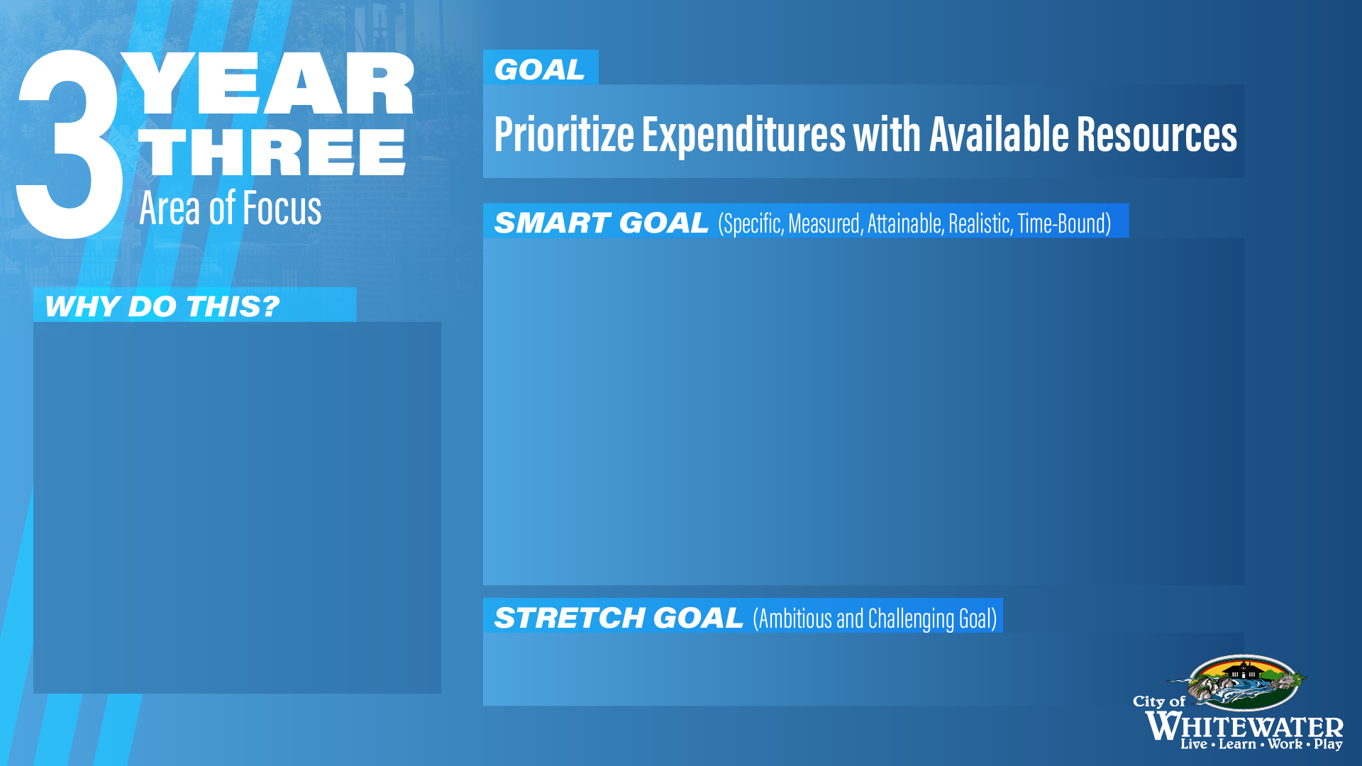
Successfully recover from permanent reduction in
revenue from the University of Wisconsin Whitewater
(UWW) for dispatch services, totaling approximately
$230,000.
Be in a position to consider targeted increases to
staffing based on an analysis of needs.
This payment’s projected
return in 2025 an beyond
needs to be allocated in
the most effective way
possible. The Public Works
garage is the building in
the most need of attention.
Begin planning for a new Public Works garage.
Notes:
MSP payments set to return in 2025. Possible increase Fire/EMS due to increased costs to city for full time operations.
We are looking into congressionally directed spending to assist with law enforcement expenses as request by Sen. Baldwin

Slide 18
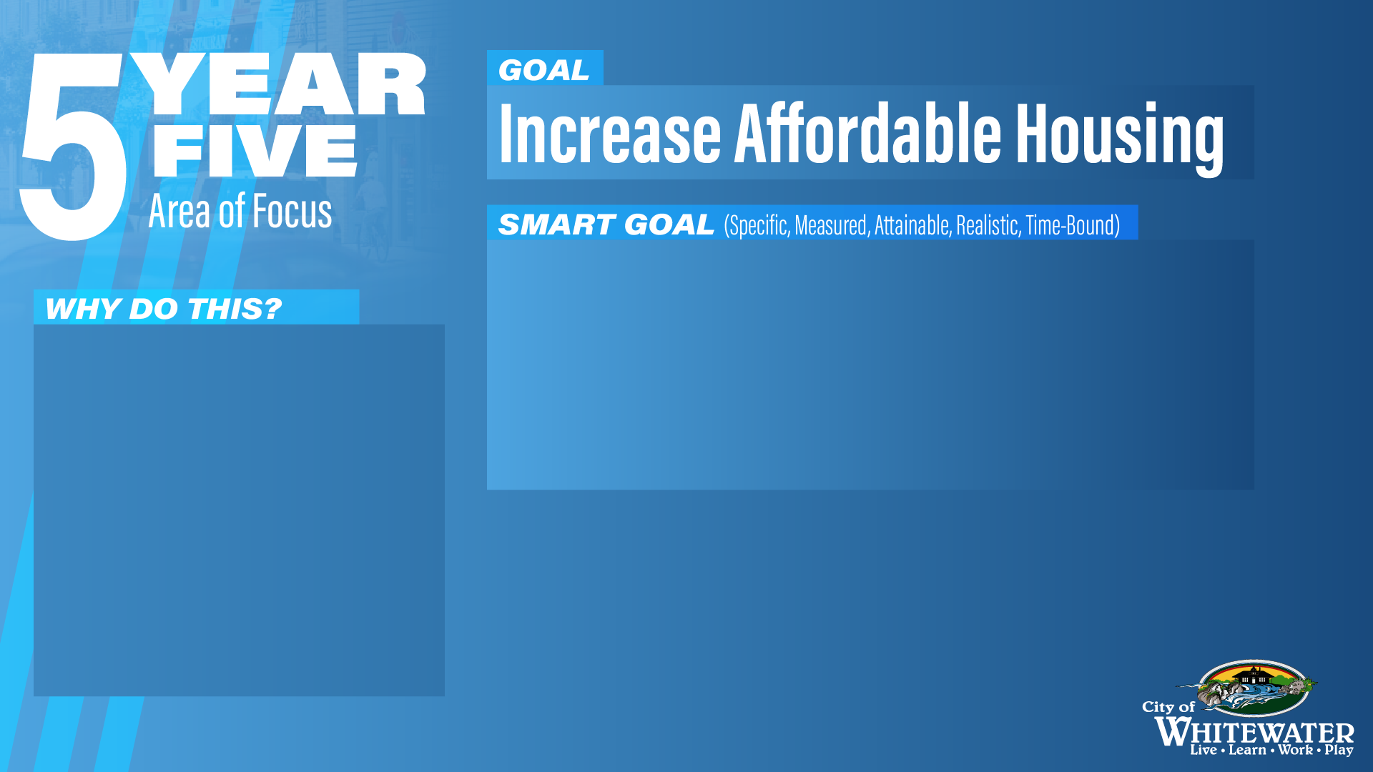
Facilitated the creation of an additional 50+ new
family-style units slated to be constructed within the
following 36 months.
Re-assess family housing needs in a follow-up study.
Creating 100 family units
helps solve the lack of
affordable housing for
single families or growing
families. The strategy
should be reviewed at the
5-year mark.
Notes:
Approval of Mound Meadows. 38 housed slated.
Meeting with residential developers on a weekly basis about future development

Slide 19
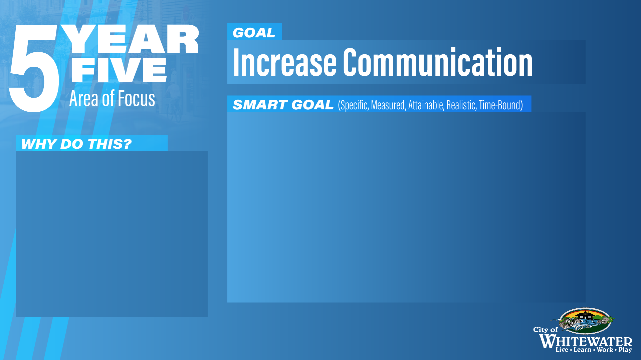
Join other social media platforms, specifically TikTok
and other social media websites that are geared
towards younger people.
Have a catalog of evergreen videos promoting the
city and its spaces.
Incorporating AI/ChatGPT into the production of said
videos, posts, press releases, etc.
Due to university students’ significant
community presence, the City has an
opportunity to reach a younger
demographic. By committing time and
resources to these platforms, we can
further reach that new demographic.
Utilizing artificial intelligence
increases the speed and
efficiency of media production.
Notes:
Media-City of Whitewater has focused there media efforts on Facebook and Instagram. We have chosen not use TikTok as a platform.

Slide 20
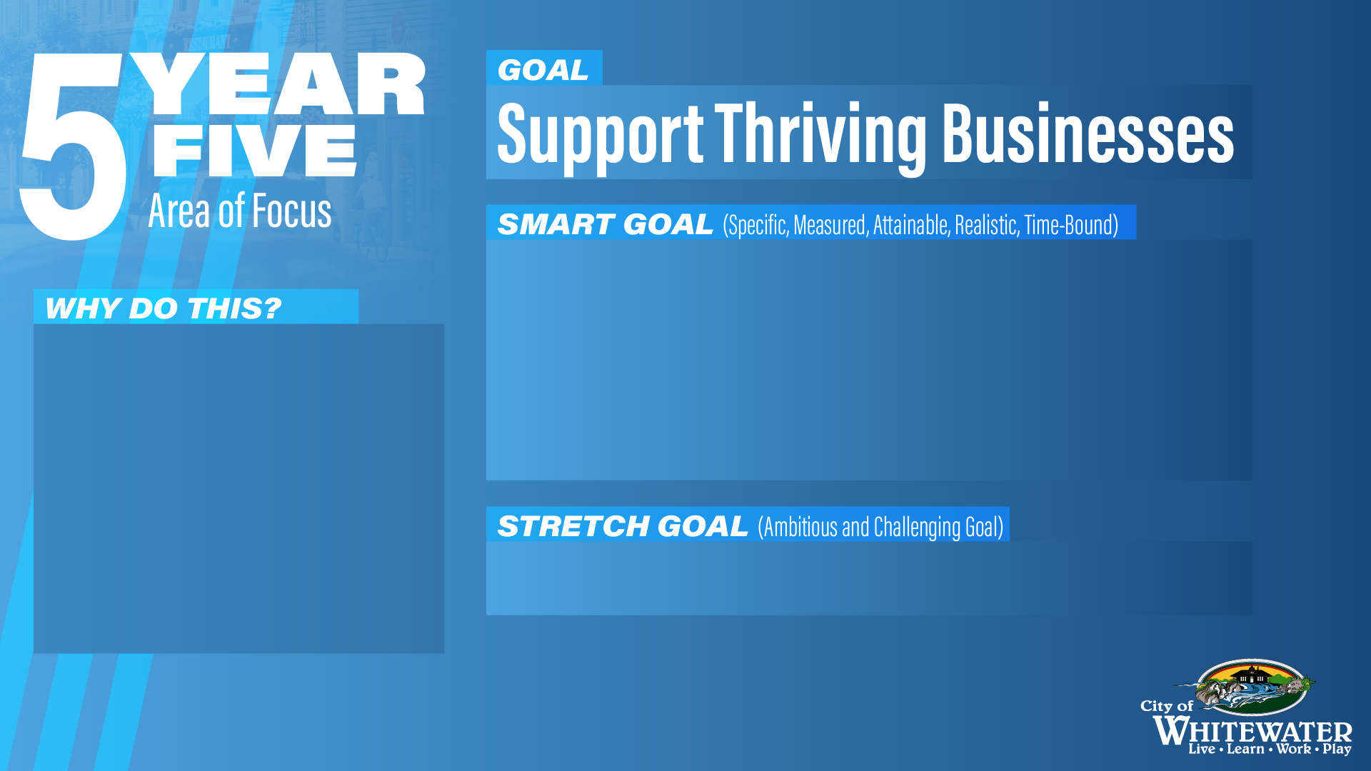
Create an onboarding and expansion process for new
businesses including points of contact, FAQ, and
available resources.
Maintain BRE meetings.
Serving as a point of
contact to new businesses
helps ensure their success
in our community and
maintains credibility in our
organization.
Turn one BRE into a new development opportunity.
Notes:
During a recent BRE visit staff was alerted to a business wanting to expand or move in larger buildings.

Slide 21
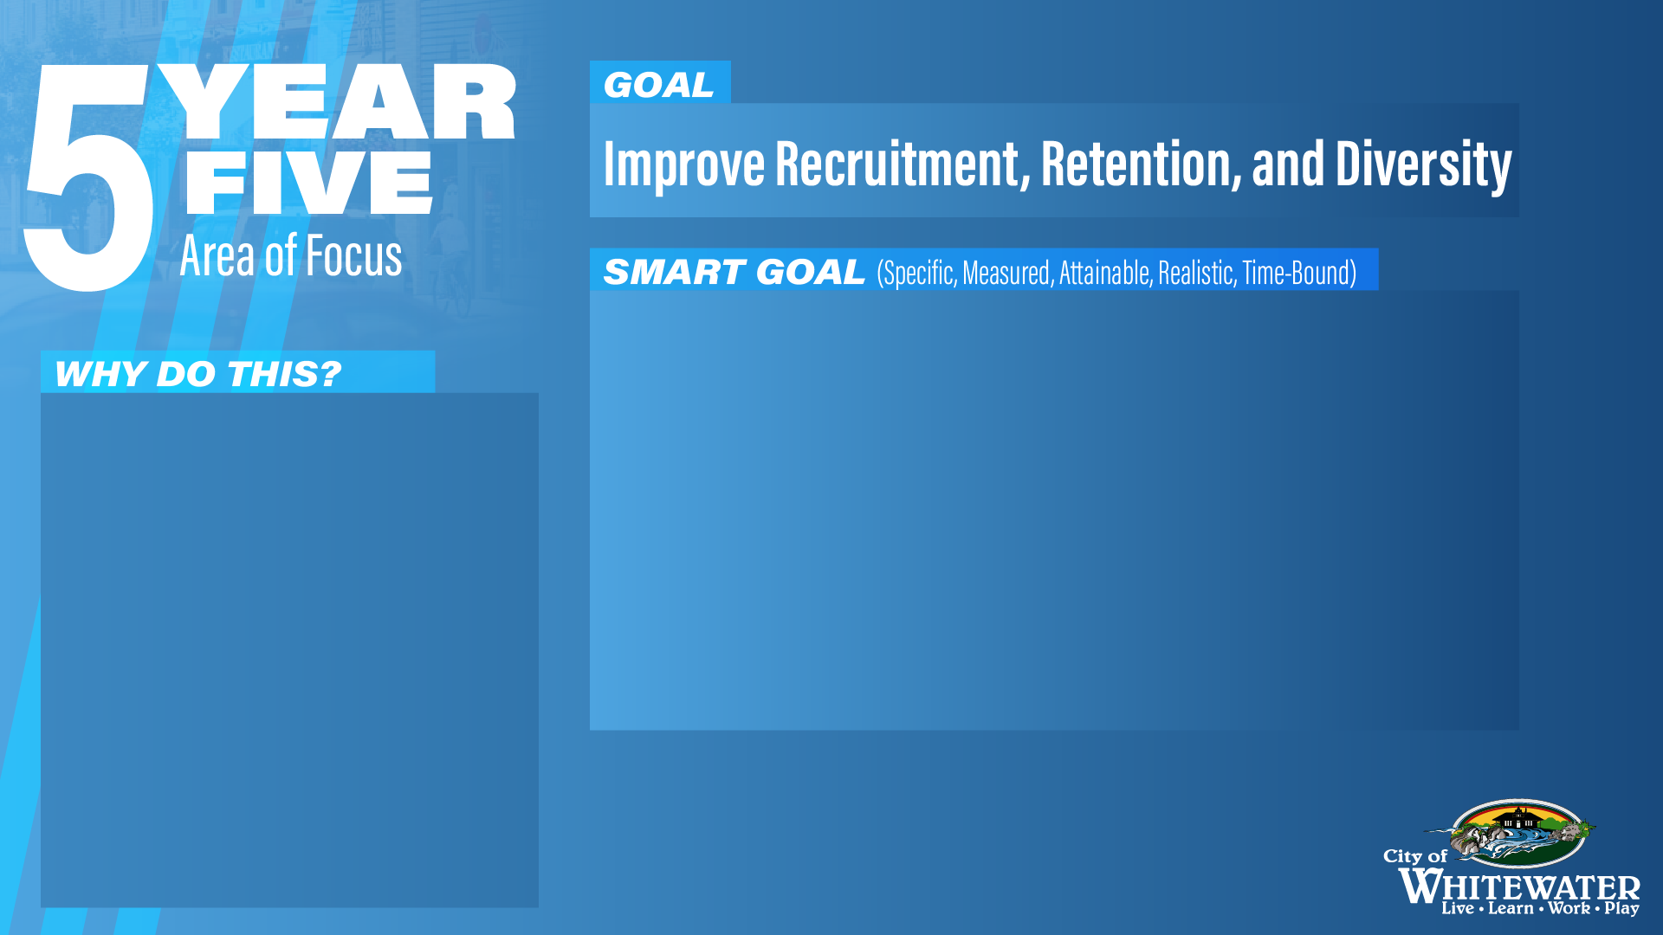
Make online onboarding department-specific and
available to all new employees.
Hit retention targets established in Year 3
100% of employees have participated in at least one
stay interview.
*Contingent on approval of the Employee Handbook*
Efficient and tailored
onboarding, vigorous
retention efforts backed by
communication with staff,
and competitive wages will
position Whitewater as a
preeminent and desirable
employer.
Notes:
Developing retention targets
Stay interviews will continue
Department- specific training and organizational training are tracked in NeoGov’s online platform

Slide 22
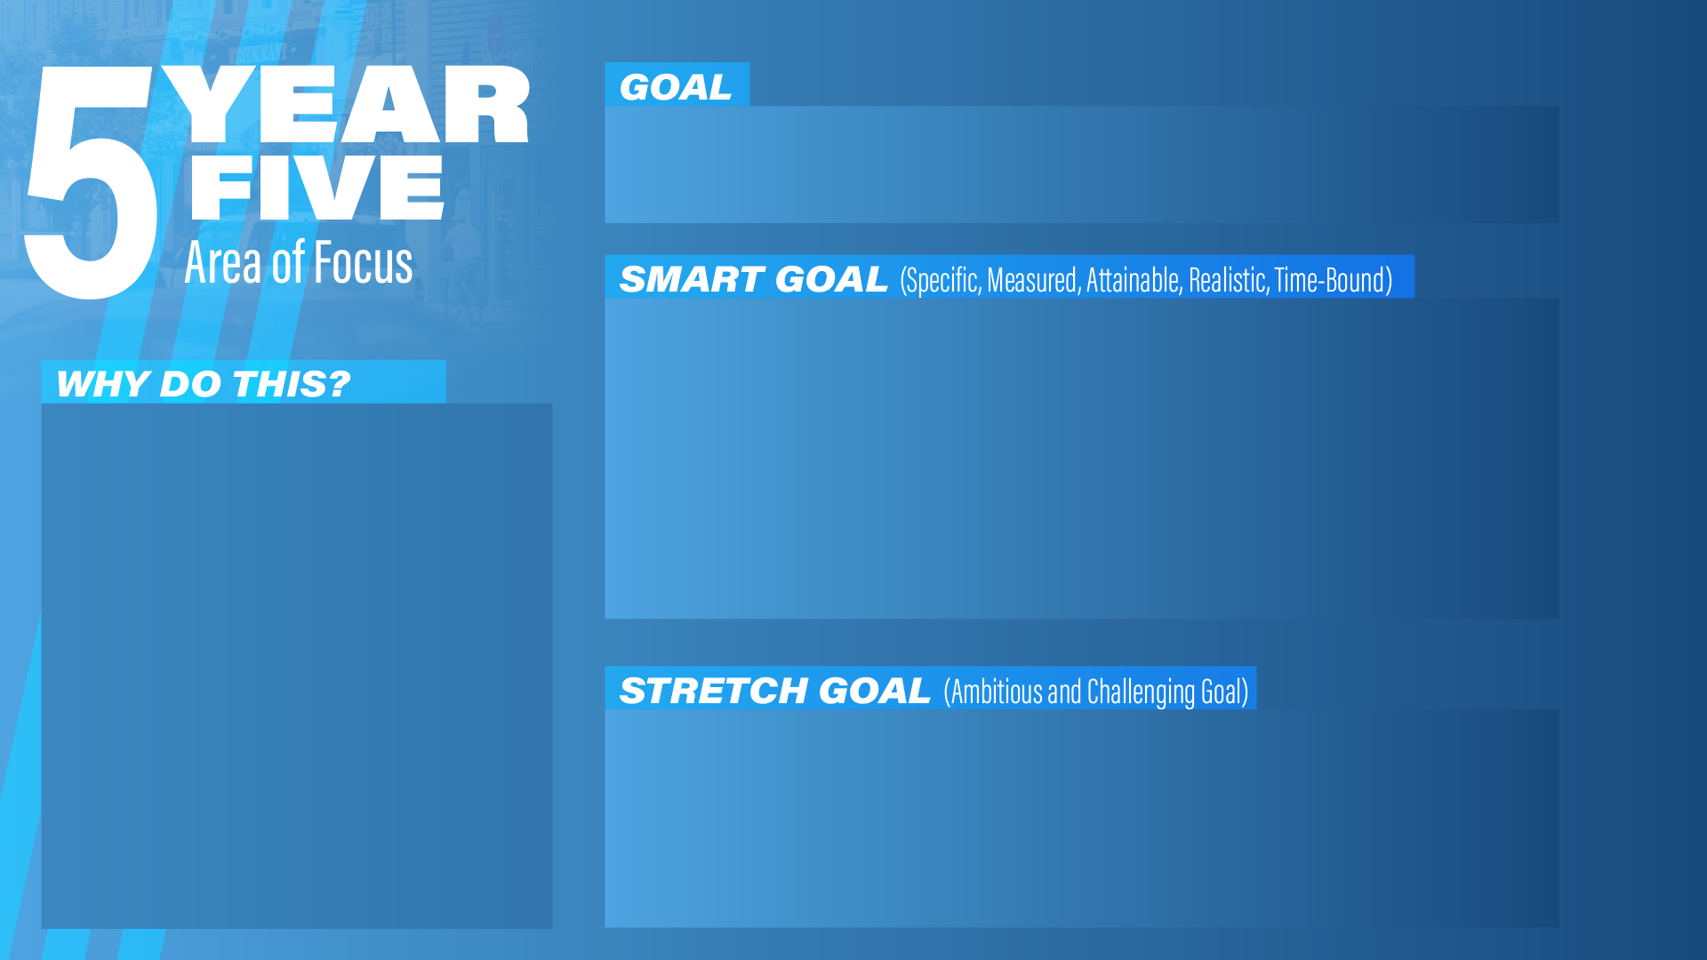
Public Transportation
Fully transition the transportation in-house model.
Monitor and evaluate the performance and cost-effectiveness of in-house services regularly.
To provide reliable and consistent transportation for our community.
Explore opportunities for expanding transportation services such as additional routes or enhances accessibility options

Slide 23
Communications
Continue to expand and innovate the content library.
Develop partnerships with local organizations and media outlets to broaden the reach and impact of community efforts.
To keep our community updated on the actions of the city government.
Establish Whitewater as a model city for transparent and responsive communication with residents.

Slide 24
Emergent Healthcare
Open the new emergent healthcare facility and begin offering services to the community.
Monitor the impact on our EMT response times and overall healthcare of the city
To have emergent healthcare services in the community
Explore opportunities to expand healthcare services based on community needs

Slide 25
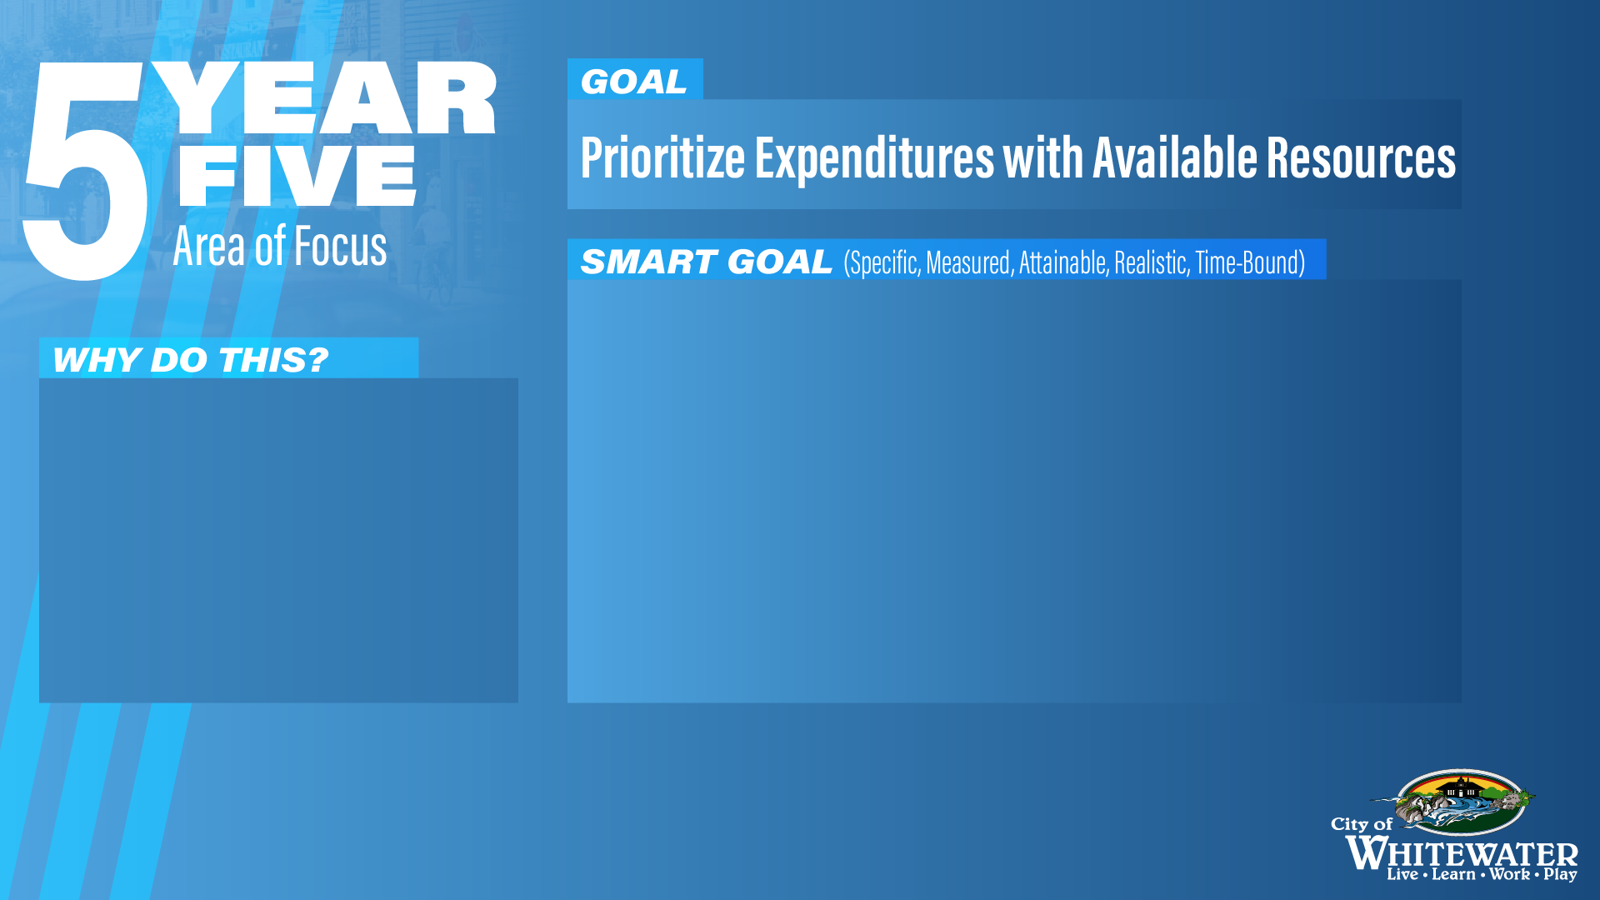
Develop and fully implement funding strategies or
revenue sources to support increased compensation
for staff recruitment and retention.
Maintain 25% + fund balance
Have a construction timeline for the Public Works
garage.
These goals not only ensure
staff that they are priority,
but ensures that the city is
financially sound with good
working conditions.

